Slide 1

Data Analysis Project for Flowers Hospital
Presented by:
Keerti Reddy Resapu

Slide 2

Contents:
Background of HRRP
Importance of ERR
Background of flowers hospital
Analysis goals
Graphs
Dashboard
Overall Findings
Insights
Recommendations

Slide 3
HOSPITAL READMISSIONS REDUCTION PROGRAM
HRRP encourages hospitals to improve communication and care coordination efforts to better engage patients and caregivers in post-discharge planning. The background of the Hospital Readmissions Reduction Program is crucial for both hospitals and patients as it addresses fundamental aspects of healthcare quality and cost-effectiveness. Here's why:
Quality of Care Measurement: The program aims to assess and improve the quality of care provided by hospitals, particularly during the transition from acute to nonacute settings. Readmission rates serve as markers, reflecting the effectiveness of the care continuum.
Patient Outcomes and Experience: Reducing preventable readmissions not only enhances the overall health outcomes for patients but also contributes to a positive healthcare experience. Patients benefit from streamlined and effective post-discharge care.
Cost Reduction and Efficiency: Successful efforts to lower readmission rates contribute to cost reduction within the healthcare system. By minimizing unnecessary readmissions, resources are allocated more efficiently, leading to potential cost savings for both hospitals and patients.
Focus on Key Medical Conditions: The program concentrates on specific medical conditions (AMI, HF, PN) with high readmission ratios. This targeted approach ensures that efforts are concentrated where the impact can be most significant, optimizing resources for improvement.
Public Reporting and Accountability: Hospitals are held accountable through public reporting of readmission ratios on platforms like the Hospital Compare website. This transparency encourages hospitals to actively engage in quality improvement initiatives, fostering a culture of accountability.
Patient-Centered Care: The emphasis on preventing unnecessary readmissions aligns with the principles of patient-centered care. It underscores the importance of ensuring a smooth and effective transition for patients, ultimately improving their overall well-being.
Summary: In summary, the background of the Hospital Readmissions Reduction Program underscores its significance in promoting high-quality, cost-effective healthcare. It encourages hospitals to prioritize patient outcomes, operational efficiency, and ongoing improvement in line with national healthcare objectives.

Slide 4
Importance of Excess Readmission Ratio
The Excess Readmission Ratio (ERR) is a key metric used in the Hospital Readmissions Reduction Program (HRRP). It measures a hospital's relative performance in managing unplanned readmissions within 30 days of discharge. The ERR is calculated as the ratio of the predicted-to-expected unplanned readmission rates.
ERR Calculation:
Predicted Ratio: The ratio of unplanned readmissions expected for a hospital, based on various factors such as patient demographics, comorbidities, and historical data.
Expected Ratio: The average ratio of unplanned readmissions for all hospitals reporting on the specific condition or procedure.
ERR Formula: Predicted Ratio / Expected Ratio
Interpretation of ERR:
ERR = 1.0: The hospital has the same ratio of unplanned readmissions as the national average.
ERR < 1.0: The hospital performs better than the national average, indicating fewer readmissions than expected.
ERR > 1.0: The hospital performs worse than the national average, suggesting more readmissions than expected.
Why ERR Matters:
Quality of Care: An ERR above 1.0 suggests potential issues in the quality of care or care transition processes, indicating that patients are more likely to be readmitted.
Patient Outcomes: Lower ERR values indicate effective care management, leading to better patient outcomes and satisfaction.
Financial Implications: HRRP adjusts Medicare payments based on a hospitals ERR. Hospitals with high ERRs may face payment reductions, emphasizing the financial importance of managing readmissions.

Slide 5

BACKGROUND OF FLOWERS HOSPITAL
Founded by Dr. Paul Flowers in 1950.
Started with 12 beds, now has 235 beds.
Shifted to a modern facility in 1983.
Provides diverse healthcare services - inpatient, outpatient, surgical, diagnostic, and emergency care.
Staffed by 1,400 healthcare professionals.
Major referral center for the Tri-State area.
Serves residents of south Alabama, southwest Georgia, and northwest Florida.
Specialized institute for heart care, recognized for advanced procedures.
Certified as an Advanced Primary Heart Attack Center.
Actively engages with the community.
Focuses on inclusivity and accessibility for all.
Complies with HIPAA guidelines for patient rights and privacy.
Participates in alliances for coordinated, high-quality care.
Commits to recruiting and retaining diversity in its workforce.
Emphasizes continuous improvement in healthcare services.
In essence, Flowers Hospital, founded by Dr. Paul Flowers, has grown into a major healthcare institution with comprehensive services, a focus on heart care, community engagement, and a commitment to inclusivity and continuous improvement.

Slide 6
Analysis goals
My data analysis project on excess readmission ratios at Flowers Hospital in Alabama aims to explore the impact of the Hospital Readmissions Reduction Program implemented by CMS in October 2012. This initiative involves reducing Medicare payments for hospitals, including flowers hospital, with excess readmissions for specific conditions: heart attack, heart failure, pneumonia, hip/knee replacement, CABG, and COPD.
National, State, and Hospital-Level Overview:
Examined excess readmission ratios (ERR) at the national, state (Alabama), and hospital (Inova Flowers) levels. Identified that the average ERR for acute myocardial infarction (AMI) and heart failure (HF) exceeded 1, indicating a higher-than-expected number of readmissions.
Graphical Representation of Average ERR: Plotted graphs to illustrate the average excess readmission ratios based on key quality indicators: Safety of Care, Timeliness of Care, Patient Experience, and Effectiveness of Care. These graphs provided a visual representation of how the hospital's performance in these categories correlates with excess readmission ratios for AMI and HF.
Evaluate Areas for Improvement: Identify and address regions, especially focusing on Flowers Hospital, where excess readmission ratios (ERR) for conditions like Heart Failure and AMI(Acute MI) exceed benchmarks.
Evaluate Care Effectiveness: Examine the impact of safety, timeliness, and patient experience on Average ERR, offering insights into the effectiveness of care delivery at national level.
Ensure Compliance: Stress the importance of meeting or surpassing regulatory standards, particularly for Flowers Hospital, to avoid penalties and ensure optimal patient outcomes. Influence healthcare policies based on actionable insights, promoting practices that enhance overall care quality and reduce excess readmissions.
Strategic Implications:
The analysis provides actionable insights for hospital administrators and healthcare practitioners to strategically address areas contributing to excess readmissions. Recommendations may include targeted improvements in safety measures, timeliness of care delivery, enhancing patient experience, and optimizing the effectiveness of care protocols.
In conclusion, my data analysis project at Flowers Hospital in Alabama offers valuable insights into the hospital's excess readmission ratios, providing a foundation for targeted quality improvement initiatives to enhance patient care and outcomes.

Slide 7

Graphs and description

Slide 8
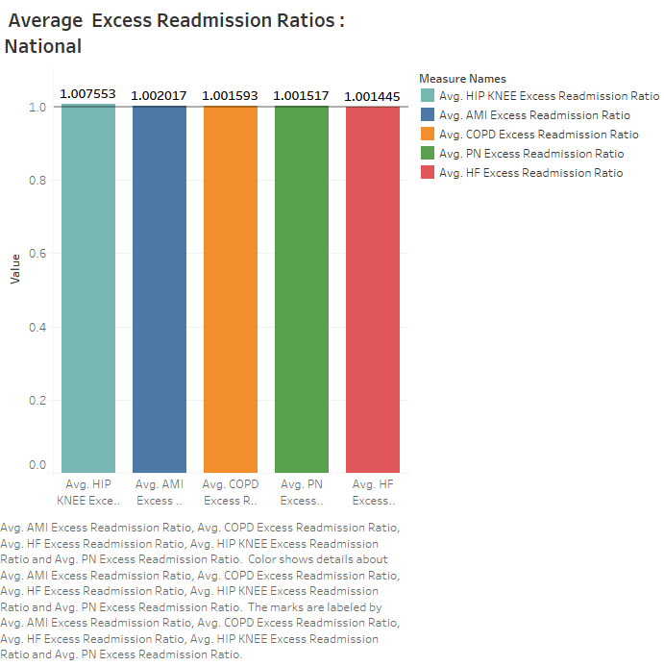
Average Excess Readmission Ratio (ERR) - National Comparison:
Graph Description: A bar graph illustrating the average ERR for different medical conditions (AMI, COPD, HF, Hip/Knee, PN) at the national level.
Key Features:
Notably, the average ERR for Hip/Knee is higher at 1.007553, signaling a potential concern as it surpasses the ideal benchmark of 1.0. In contrast, Heart Failure demonstrates the lowest average ERR at 1.001445.
The average ERR for AMI is 1.002017, COPD is 1.001593, and PN is 1.001517. While these ratios are slightly above the benchmark, the higher ERR for Hip/Knee at 1.007553 suggests a potential area for improvement, as exceeding 1.0 may result in penalties for the hospital.
Overview:
This graphical representation illustrates the comparison between the national average excess readmission ratios (ERRs) for different medical conditions, including AMI, Hip/Knee, HF, PN, and COPD. The variations in these ratios, especially the elevated ERR for Hip/Knee, underscore the importance of targeted interventions and quality improvement initiatives to ensure compliance with regulatory standards and enhance overall patient care.

Slide 9
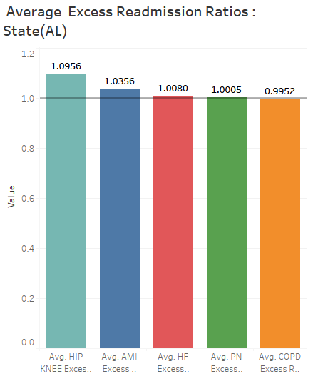
The bar graph illustrates the Average Excess Readmission Ratios (ERR) for key medical conditions across various hospitals in Alabama. Each bar represents a specific medical condition (AMI, COPD, HF, HIP and KNEE, PN), showcasing the state's performance in terms of continuity of care beyond hospital stays.
Key Findings: Heart Failure (HF):Average ERR: 1.0080.Hospitals in Alabama exhibit commendable performance, indicating improvement to reduce penalties for the hospital.
AMI (Acute Myocardial Infarction):Average ERR: 1.0356.Slightly above the desired threshold, indicating potential areas for improvement in post-hospital care for AMI patients.
COPD (Chronic Obstructive Pulmonary Disease):Average ERR: 0.9952.Demonstrating strong performance, hospitals maintain a low ERR for COPD cases, meeting or even exceeding expectations.
PN (Pneumonia):Average ERR: 1.0005.Close to the acceptable threshold, suggesting a need for minor refinements in post-hospital care for pneumonia patients.
HIP and KNEE: Average ERR: 1.0956.Significantly higher than the ideal benchmark, highlighting a potential concern. Hospitals with ERRs above 1.0 face scrutiny and potential penalties, emphasizing the importance of targeted interventions for better continuity of care in hip and knee cases.
Implications: The graph provides a visual snapshot of Alabama's healthcare landscape, indicating strengths and areas for improvement. Focused attention on enhancing post-hospital care for AMI and especially HIP and KNEE cases is essential to align with regulatory standards and ensure optimal patient outcomes. This analysis serves as a valuable guide for healthcare stakeholders in directing efforts towards areas that can positively impact the continuity of care.

Slide 10
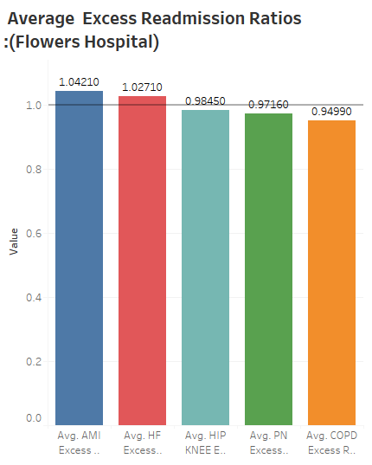
The bar chart illustrates the average excess readmission ratios (ERR) for different medical conditions at Flowers Hospital. Here's a brief breakdown:
AMI (Acute Myocardial Infarction): Average ERR: 1.04210. Indicates a slightly higher than expected ratio of readmissions for patients with heart attacks. Further investigation into post-treatment care and follow-up procedures may be beneficial.
HF (Heart Failure): Average ERR: 1.02710. Heart failure cases show a moderately elevated ratio of readmissions. Exploring strategies to improve transitional care and patient education post-discharge could be valuable.
HIP (Hip Replacement): Average ERR: 0.98450. Hip replacement cases exhibit a lower-than-expected ratio of readmissions. This suggests effective surgical and postoperative care protocols, contributing to positive patient outcomes.
PN (Pneumonia): Average ERR: 0.97610. Pneumonia cases demonstrate a lower-than-expected readmission ratio, indicating successful treatment and aftercare strategies.
COPD (Chronic Obstructive Pulmonary Disease): Average ERR: 0.94990. COPD cases have the lowest ERR, implying a lower-than-expected ratio of readmissions. Identifying and implementing effective COPD management practices could be beneficial for overall patient care.

Slide 11
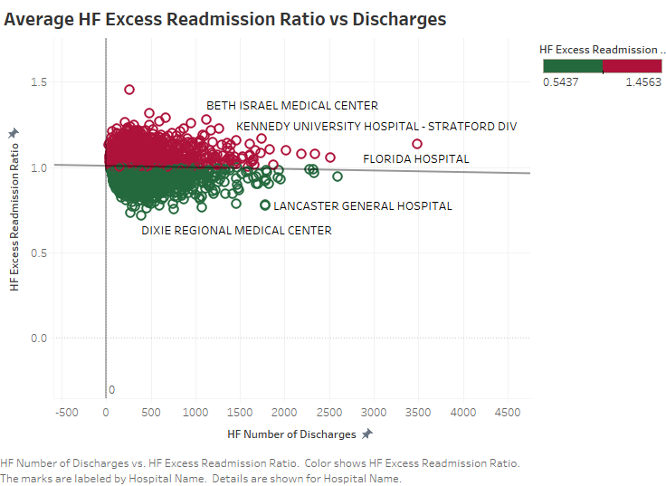
Scatter Plot Interpretation:
In the scatter plot graph, we explore the relationship between the number of heart failure (HF) discharges and the average HF Excess Readmission Ratio (ERR) across various hospitals. Each point on the plot represents a specific hospital, labeled for clarity.
Key Observations:
Downward Trend: The plot reveals a slight downward trend, indicating that, on average, as the number of HF discharges increases, the ERR tends to slightly decrease. This trend suggests a potential association between higher patient volumes and more efficient care practices, leading to reduced readmission ratios.
Hospital-Specific Insights: By labeling each point with the corresponding hospital name, the graph provides a detailed view of individual hospital performance. Some hospitals may stand out as high performers, consistently maintaining lower ERR values even with varying discharge numbers.
Interpretation by Hospital Name:
Florida hospital: Positioned higher on the graph with higher ERR values, suggesting challenges in managing HF patients and higher-than-expected readmission ratios.
Maine medical center: Positioned lower on the graph with lower ERR values, indicating effective management of HF patients with varying discharge numbers.
Implications:
Efficiency Improvement: Hospitals experiencing a decrease in ERR with rising discharges may have implemented more efficient processes or focused interventions, contributing to better patient outcomes.
Benchmarking: Identification of high-performing hospitals serves as a benchmark for others, offering insights into potential strategies to enhance care practices and reduce readmission ratios.

Slide 12
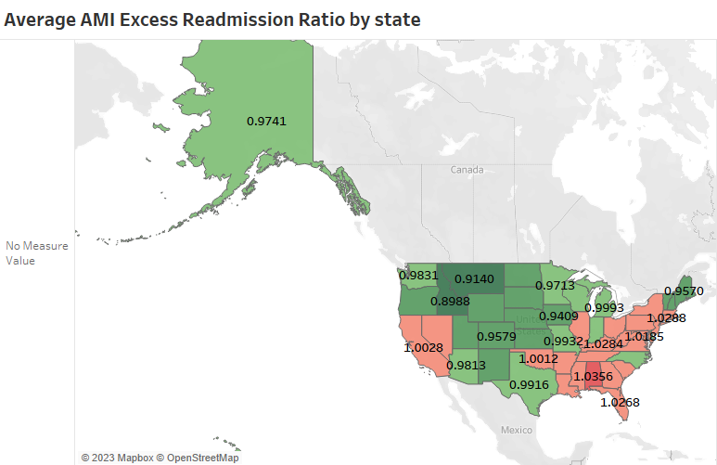

Slide 13
Graph Description:
The map graph visualizes the excess readmission ratios (ERR) for AMI in different states across the USA. The ERR values represent the comparison of each state’s AMI readmission ratios to the national average, which is denoted by 1.000.
Key Insights:
Below-Average ERR (ERR < 1.0): States like Maine (ME) and Nebraska (NE) showcase effective AMI management, resulting in fewer readmissions than the national average. These areas serve as benchmarks for successful care practices.
Above-Average ERR (ERR > 1.0): Regions in New York (NY) ,Alabama(AL), Florida (FL) exhibit higher AMI readmission ratios than the national average. Identifying challenges in these areas can guide targeted interventions to enhance patient outcomes.
Importance of Mapping:
Regional Disparities: Mapping ERR values reveals spatial variations in AMI care outcomes, aiding healthcare professionals in identifying areas with differing performance levels.
Targeted Interventions: Identifying regions with above-average ERRs enables healthcare providers to implement interventions and improve care practices, ultimately reducing readmissions.
Map Orientation:
The west and mid-west side of the map, featuring ERR values below 1.0, signifies regions with potentially more effective AMI management and lower readmission ratios.
The south side of the map, with ERR values above 1.0, highlights areas that may require additional attention and interventions to bring about improvements in AMI care.
Conclusion:
The color-coded map graph visually communicates regional variations in AMI care outcomes. The use of red (ERR > 1) and green (ERR < 1) aids in easily identifying areas that may need focused interventions for improved patient care based on ERR interpretations.

Slide 14
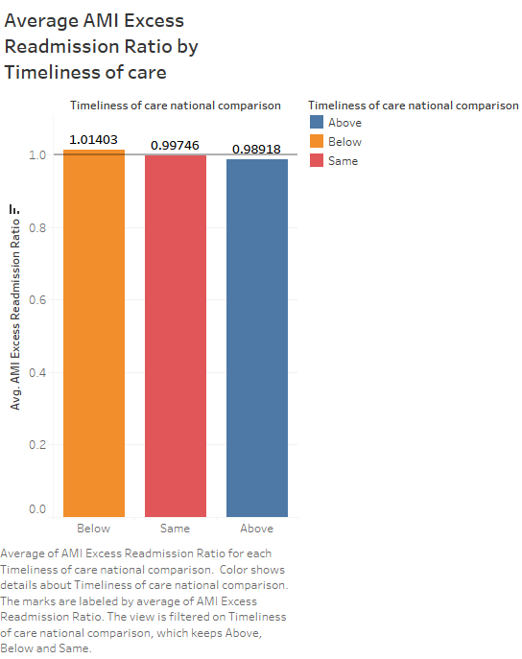
Interpretation:
Same as National Comparison (0.99746):
When the timeliness of care matches the national average, the AMI Excess Readmission Ratio (ERR) is close to 1.0. This suggests a baseline level of risk.
Below National Comparison (1.01403):
A rise in AMI ERR above 1.0 indicates that falling below the national benchmark for timeliness of care increases the risk of readmission. This highlights the critical role of timely care in mitigating readmission risk for AMI patients.
Above National Comparison (0.98918):
Conversely, when timeliness of care exceeds the national average, the AMI ERR drops below 1.0. This signals a potential reduction in the risk of readmission, emphasizing the importance of efficient and prompt care delivery.
Key Point: Timeliness of care plays a pivotal role in determining the risk of readmission for Acute Myocardial Infarction (AMI) cases at flowers hospital. Consistently meeting or surpassing national benchmarks for timeliness is associated with better outcomes and a lower likelihood of readmission. This underscores the significance of prioritizing and optimizing timely care practices in managing AMI patients effectively.

Slide 15
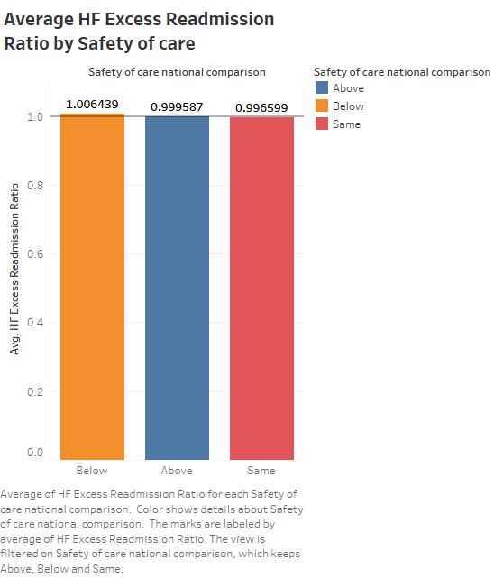
Interpretation:
Same as National Average Safety of Care (0.996599):
When the safety of care aligns with the national average, the Excess Readmission Ratio (ERR) for Heart Failure (HF) remains relatively low. This implies that maintaining standard safety measures in care contributes to lower risks of readmission for heart failure.
Below National Average Safety of Care (1.006439):
Falling below the national benchmark for safety of care increases the ERR for heart failure. This suggests that compromising on safety measures may elevate the likelihood of readmission for heart failure patients.
Above National Average Safety of Care (0.999587):
Conversely, when the safety of care surpasses the national average, the ERR for heart failure decreases. This highlights the importance of maintaining high safety standards in care to reduce the risk of readmission for heart failure.
Key Features: Safety of care is a crucial determinant. Adhering to or exceeding national safety benchmarks is associated with lower risks of readmission for heart failure. This underscores the significance of maintaining a safe care environment for better outcomes in heart failure management.

Slide 16
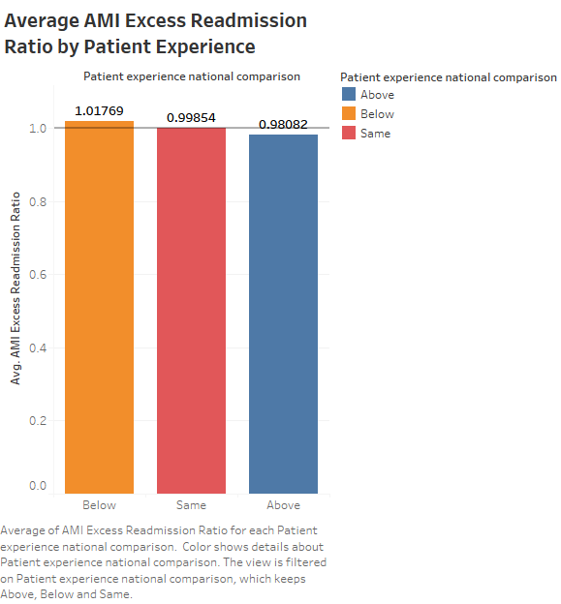
Interpretation:
Average Patient Experience (0.99854):
The risk of patients being readmitted for Acute Myocardial Infarction (AMI) is standard when their experience aligns with the national norm. It's like a typical or expected level of risk.
Below Average Patient Experience (1.01769):
If patient experiences fall below the national benchmark, the risk of AMI readmission increases. Providing fewer positive experiences may elevate the likelihood of patients returning.
Above Average Patient Experience (0.98082):
Conversely, when patient experiences surpass the national average, the risk of AMI readmission decreases. This hints that exceptionally positive patient experiences could reduce the chances of patients coming back.
Conclusion:
Patient experience is crucial. Aiming for experiences beyond the national average lowers the risk of AMI readmission, emphasizing the importance of exceptional and patient-centered care for better outcomes.

Slide 17
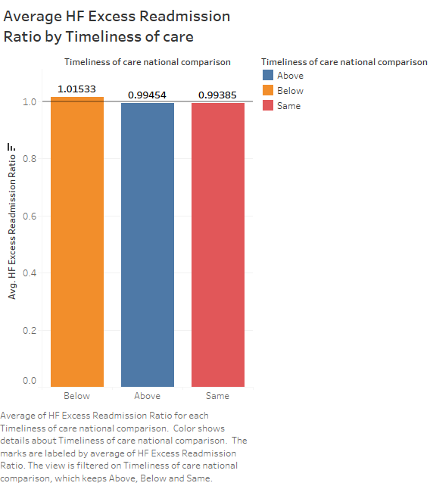
Interpretation:
Same as National Average Timeliness of Care (0.99385):
When timeliness of care aligns with the national average, the Excess Readmission Ratio (ERR) for Heart Failure (HF) is relatively low. This suggests that maintaining a standard level of timeliness contributes to lower risks of readmission for heart failure.
Below National Average Timeliness of Care (1.01533):
Falling below the national benchmark for timeliness of care increases the ERR for heart failure. This indicates that delays or slower response times may elevate the likelihood of readmission for heart failure patients.
Above National Average Timeliness of Care (0.99454):
Conversely, when timeliness of care surpasses the national average, the ERR for heart failure decreases. This emphasizes the importance of quick and efficient care in reducing the risk of readmission for heart failure.
Key points: Timeliness of care has significant impact on Heart Failure readmission ratio at Flowers Hospital. Meeting or exceeding national benchmarks in responding promptly to heart failure cases is associated with lower risks of readmission. This highlights the significance of timely and efficient care for better outcomes in heart failure management.

Slide 18
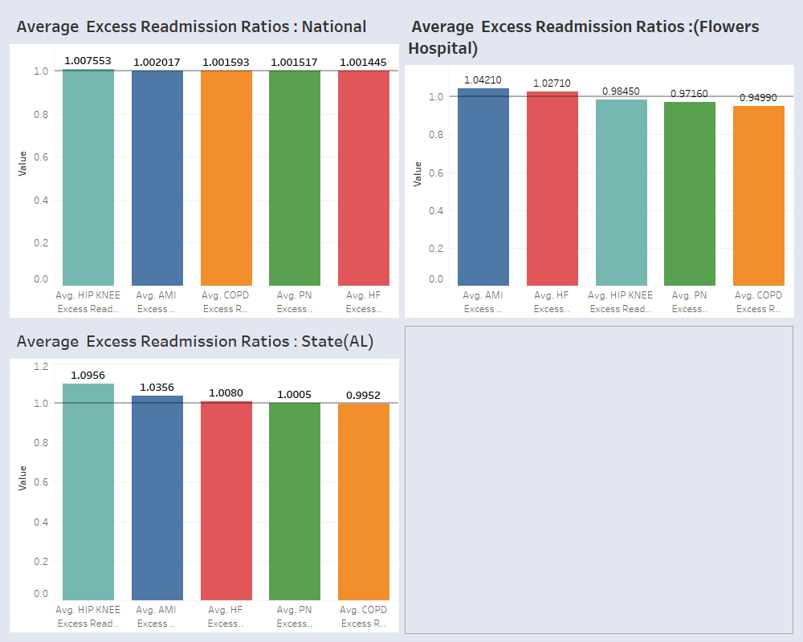
Dashboard showing Average ERR FOR Nation, State, Flowers Hospital and Web Page

Slide 19
Dashboard Description
Dashboard provides a multi-dimensional view of readmission ratios, allowing for a thorough analysis. The inclusion of Flowers Hospital and its web page adds a layer of transparency, enabling users to access detailed information about the hospital's performance. The comparison with national and state averages offers valuable context and benchmarks. Dashboard is user-friendly and informative for a holistic understanding of readmission patterns. My dashboard includes four key graphs:
Average ERR for Hospitals: This graph captures the overall excess readmission ratios (ERR) for heart failure for Flowers hospital.
National Average ERR: This graph captures the overall excess readmission ratios (ERR) for heart failure nationwide.
State Average ERR: Similar to the national comparison, this graph allows for a more localized assessment, considering the Alabama state's benchmarks.
Flowers Hospital's Performance: By directly incorporating Flowers Hospital's data, offering users a detailed look at its readmission ratios. This could be an interactive graph, allowing users to explore different aspects of the hospital's performance.
Additionally, linking to Flowers Hospital's web page enhances transparency and accessibility, allowing users to delve deeper into the hospital's background, services, and any additional information they might seek.
The overall goal appears to be a comprehensive analysis of Flowers Hospital's readmission ratios in various contexts, promoting transparency, benchmarking against national and state standards, and providing a user-friendly interface for stakeholders.

Slide 20

Findings

Slide 21
National ERR Analysis:
Hip/Knee conditions stand out with a concerning average ERR (1.007553), surpassing the ideal benchmark. Heart Failure performs well with the lowest ERR (1.001445). While AMI, COPD, and PN show minor elevations, the focus on higher ERR in Hip/Knee calls for urgent targeted interventions and quality improvement.
Alabama State ERR Comparison:
Heart Failure leads with an ERR of 1.0080, signaling progress. AMI indicates improvement opportunities (1.0356), COPD excels (0.9952), PN needs minor adjustments (1.0005), and Hip/Knee conditions raise concerns (1.0956). This snapshot guides efforts to enhance post-hospital care, aligning with regulatory standards for optimal outcomes.
Flowers Hospital ERR Overview:
AMI slightly elevated (1.04210) prompts post-treatment care investigation. HF moderately elevated (1.02710) emphasizes improved transitional care. HIP positive outcomes (0.98450), PN, and COPD successful aftercare (0.97610, 0.94990) guide targeted enhancements in post-hospital care.
HF Discharges vs. Avg ERR - National Comparison:
Subtle decline in ERR with increasing HF discharges suggests a link to improved outcomes, prompting investigation for targeted improvements and enhanced patient care.
Heart Failure Care Across the USA:
Regional analysis reveals benchmarks in Maine and Nebraska (ERRs below 1.0), while New York, Alabama, and Florida indicate areas for interventions. Disparities highlight effective management in the west and mid-west, suggesting additional attention in the south.
AMI Readmission Risk and Timeliness:
Analysis emphasizes the impact of timely care on outcomes. National average aligning maintains baseline risk (0.99746), falling below escalates risk (1.01403), and surpassing the benchmark reduces risk (0.98918). Consistent adherence or exceeding national standards is crucial for managing AMI patients effectively. Flowers hospital is below the national comparison of timeliness of care.

Slide 22
HF Readmission Risk and Safety of Care:
HF analysis underscores safety impact. National average alignment results in low ERR (0.996599), falling below safety benchmark increases ERR (1.006439), and surpassing the safety average reduces ERR (0.999587). Adhering to or exceeding safety benchmarks is crucial for optimal HF management and minimizing readmission risks. Flowers hospital is below the national comparison of safety of care.
AMI Readmission Risk & Patient Experience:
National Average (0.99854): Standard risk when patient experience aligns with the national norm.
Below Average (1.01769): Lower patient experiences increase AMI readmission risk.
Above Average (0.98082): Higher patient experiences decrease AMI readmission risk.
Conclusion: Exceptional patient-centered care reduces AMI readmission risk.
Flowers hospital is below the national comparison of patient experience.
HF Readmission & Timeliness:
National Average (0.99385): Standard timeliness results in lower HF readmission risk.
Below Average (1.01533): Delays elevate HF readmission risk.
Above Average (0.99454): Quick, efficient care reduces HF readmission risk.
Key points: Timely care is crucial for lower HF readmission risks at Flowers Hospital. Meeting or exceeding benchmarks correlates with better outcomes.
Dashboard Overview:
The dashboard provides a comprehensive view of readmission ratios, enhancing transparency and analysis. Flowers Hospital's inclusion, with a dedicated web page link, offers detailed performance insights. Comparisons with national and state averages provide crucial context and benchmarks. The user-friendly interface, featuring four key graphs, facilitates a holistic understanding of readmission patterns. The goal is to promote transparency, benchmarking, and accessibility, aligning with Flowers Hospital's commitment to comprehensive analysis and stakeholder engagement.

Slide 23
Insights for Flowers Hospital:
1. Precision in Intervention Strategies: The assessment distinctly points to specific medical domains—Heart Failure (HF), Acute Myocardial Infarction (AMI), and Hip/Knee surgeries—demanding targeted interventions. Flowers Hospital gains valuable insights to refine strategies, ensuring a precise focus on these critical areas for optimal patient care.
2. Time, Effectiveness, and Patient-Centric Experiences: A fundamental revelation emerges regarding the pivotal role of timely care, intervention effectiveness, and positive patient experiences. Flowers Hospital is urged to place a premium on these elements, recognizing their direct influence on diminishing excessive readmissions. Elevating standards in these facets will be a transformative step toward improved patient outcomes.
3. Strategic Improvement and Compliance: The analysis becomes a strategic compass for Flowers Hospital, spotlighting areas earmarked for enhancement. By rectifying identified shortcomings in targeted medical conditions and care modalities, Flowers Hospital not only improves patient results but also aligns seamlessly with national benchmarks. This approach isn't just a route to excellence—it's a commitment to regulatory compliance, ensuring Flowers Hospital's healthcare delivery consistently meets the highest standards.

Slide 24
Recommendations for Readmission Reduction at Flowers Hospital
Short-Term Strategies:
Enhance Transitional Care: Implement a robust transitional care program, ensuring seamless coordination and continuity of care during patient transitions from hospital to home.
7-Day Follow-Up Implementation: Emphasize the importance of scheduling follow-up visits within seven days of discharge, promoting timely post-hospital care and reducing the risk of readmissions.
Patient Education and Communication: Strengthen patient education initiatives, utilizing effective communication methods such as the "Teach Back" approach to ensure patients understand post-discharge instructions and manage their conditions.
Telemonitoring Integration: Explore the integration of telemonitoring technology for chronically ill patients, allowing for real-time monitoring and early intervention to prevent potential complications.

Slide 25
Long-Term Strategies:
Invest in Nurse Staffing: Focus on maintaining optimal nurse staffing levels, ensuring adequate coverage to provide high-quality care and effective discharge teaching, leading to improved patient outcomes.
Collaborate in Incentive Programs: Continue collaboration with payors in incentive programs that align with federal accountable care guidelines, promoting collaboration between hospitals and physicians to reduce hospital-acquired infections and readmissions.
Participate in Readmission Prevention Collaboratives: Engage in readmission prevention-focused collaboratives, fostering the exchange of best practices and strategies with other healthcare providers to collectively reduce readmissions. Continuous Quality Improvement Establish a culture of continuous quality improvement, regularly reviewing readmission data, and implementing adaptive strategies to address emerging trends and challenges.
Chronic Disease Management Programs: Strengthen chronic disease management programs, particularly for conditions like heart failure and acute myocardial infarction, to enhance post-hospital care and reduce the likelihood of readmissions.
Patient-Centric Approach: Prioritize a patient-centric approach in all aspects of care, ensuring a positive patient experience, addressing individual needs, and fostering a sense of empowerment in managing their health.
By focusing on these short-term and long-term strategies, Flowers Hospital can proactively address the underlying factors contributing to excess readmissions, ultimately improving patient outcomes and aligning with regulatory standards.

Slide 26
References:
1.)5061.pdf (hfma.org)
2.)Hosp. Readmission Reduction | CMS
3.)Heart Failure Readmission Prevention Case Study | HIMSS

Slide 27

Thank you

